Slide 1
Finite Automata With Output

Slide 2
Finite Automata
Finite Automata
With Output
Without Output
Mealy Machine
Moore Machine
DFA
NFA
NFA-ɛ

Slide 3
Cont….
Finite Automata(FA) without output is the simplest abstract machine to recognize patterns
FA with output is similar to finite automata (FA) except that the additional capability of producing output. In a formal way it is also known as Finite State Machine (FSM) or Transducer.
FSM = Transducer = Finite automata with output = Finite automata + Output Capability

Slide 4
FINITE AUTOMATA WITH OUTPUT
Moore Machine
Mealy Machine
FINITE AUTOMATA
WITH OUTPUT
λ Q = Δ
λ Q * Ʃ = Q
Mealy and Moore machine consist of SIX TUPLE:
(Q, Ʃ, δ, qo, Δ, λ)
Q= Set of States
Ʃ= Set of Alphabets
δ= Transition Table
q0= Initial State
Δ= Set of Output alphabets (Output Symbol)
λ= Output Mapping Function

Slide 5
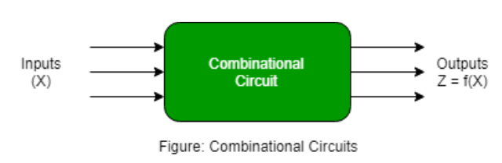
Combinational Circuits
Combinational circuits are defined as the time independent circuits which do not depends upon previous inputs to generate any output are termed as combinational circuits.

Slide 6
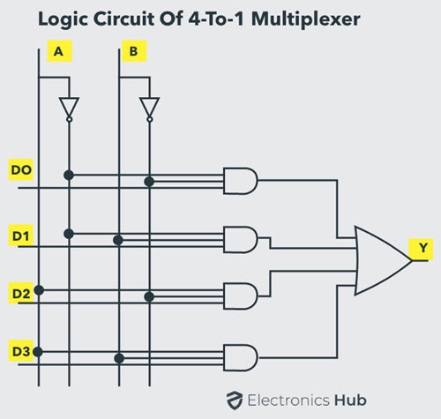
Cont…
In this output depends only upon present input.
Speed is fast
There is no feedback between input and output.
This is time independent.
Elementary building blocks: Logic gates
Used for arithmetic as well as boolean operations.
Combinational circuits don’t have capability to store any state.
As combinational circuits don’t have clock.
Examples – Encoder, Decoder,
Multiplexer, Demultiplexer

Slide 7
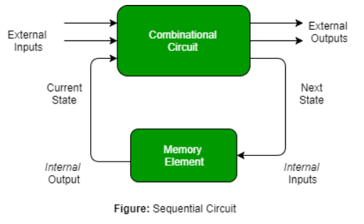
Sequential Circuits
Sequential circuits are those which are dependent on clock cycles and depends on present as well as past inputs to generate any output.

Slide 8
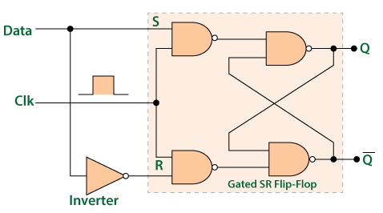
Cont…
In this output depends upon present as well as past input.
Speed is slow.
It is designed tough as compared to combinational circuits.
There exists a feedback path between input and output.
This is time dependent.
Elementary building blocks: Flip-flops
Mainly used for storing data.
Sequential circuits have capability to store any state or to retain earlier state.
Clock dependent
These circuits have memory element.
Examples – Flip-flops, Counters

Slide 9
Addition using combinational and sequential circuits
Add five integers using combinational and sequential circuits

Slide 10
Moore versus Mealy machines
Moore machine
Outputs are a function
of current state
Outputs change
synchronously with
state changes
inputs
combinational logic for next state
reg
logic for outputs
outputs
state feedback
inputs
logic for outputs
outputs
Mealy machine
Outputs depend on state
and on inputs
Input changes can cause immediate output changes
(asynchronous)
combinational logic for next state
reg
state feedback

Slide 11
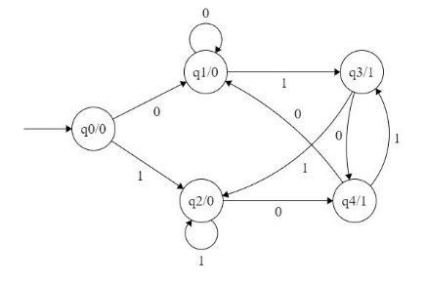
Moore Machine
In the moore machine, the output is represented with each input state
separated by /.
The length of output for a moore machine is greater than input by 1.
Input: 11
Transition: δ (q0,11)=> δ(q2,1)=>q2
Output: 000 (0 for q0, 0 for q2 and again 0 for q2)

Slide 12
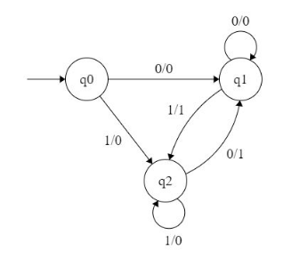
Mealy Machine
In the mealy machine shown in Figure 1, the output is represented with each
input symbol for each state separated by /.
The length of output for a mealy machine is equal to the length of input.
Input:11
Transition: δ (q0,11)=> δ(q2,1)=>q2
Output: 00 (q0 to q2 transition has Output 0 and q2 to q2 transition also has Output 1

Slide 13
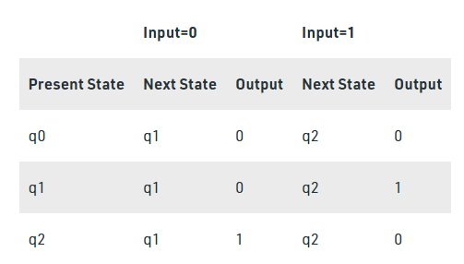
Mealy Machine

Slide 14
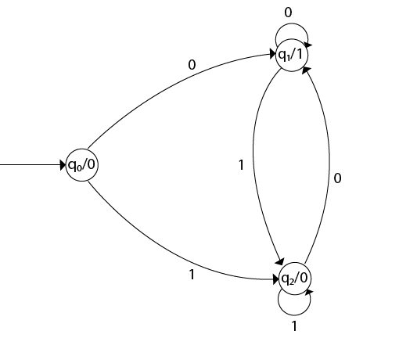
Moore Machine
Design a Moore machine to generate 1's complement of a given binary number
Solution: To generate 1's complement of a given binary number the simple logic is that if the input is 0 then the output will be 1 and if the input is 1 then the output will be 0. That means there are three states. One state is start state. The second state is for taking 0's as input and produces output as 1. The third state is for taking 1's as input and producing output as 0.

Slide 15
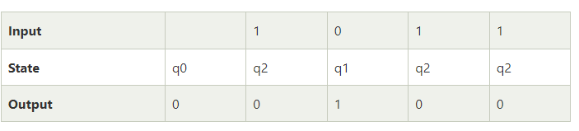
Cont…
For instance, take one binary number 1011

Slide 16
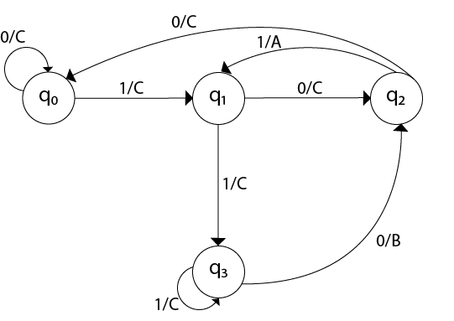
Mealy Machine
Design a Mealy machine for a binary input sequence such that if it has a substring 101, the machine output A, if the input has substring 110, it outputs B otherwise it outputs C.
Solution: For designing such a machine, we will check two conditions, and those are 101 and 110. If we get 101, the output will be A. If we recognize 110, the output will be B. For other strings the output will be C.

Slide 17
4-bit Sequence detector

